Slide 1




Slide 2

Introduction to linux

Slide 3


Table of content
1- History of linux
2- Linux distributions
3- Where linux is used ?
4- Basic linux commands
5- Why choosing linux ?
6- Installation
7- Q&A

Slide 4
History of linux

Slide 5



Open source operating system created
by Linus torvalds in 1991
He created what we called the linux kernel
and them with the gnu project became complete
operating system
Tux (penguin) is the official brand for
linux kernel

Slide 6

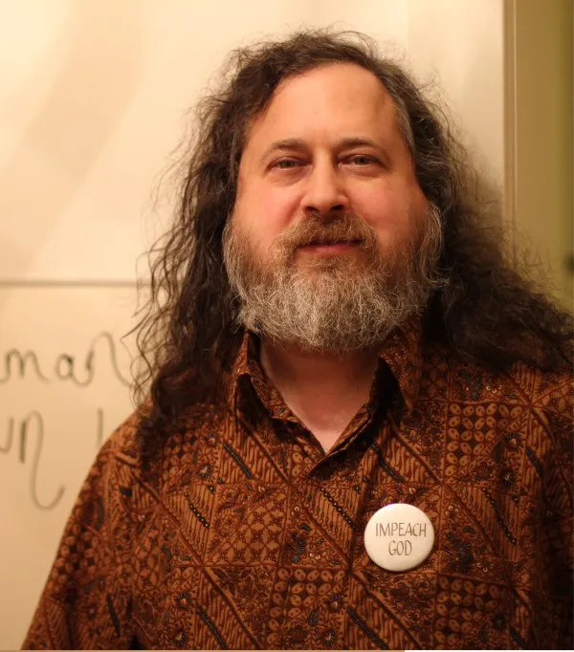
The gnu project create by Richard Stallman
in 1985
The gnu project is a group of free software that makes an os usable for human

Slide 7

GNU project + Linux Kernel

Slide 8
Linux distributions

Slide 9




Distribution (distro) is a complete operating system based on the linux kernel that contains a bunch of packages, libraries and a package manager
There is a lot of distributions for linux like: Debian, Redhat, Arch linux …etc

Slide 10

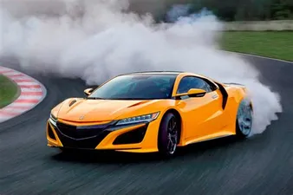




Why we have a lot of distro: Each distro is specialise in specific thing just like cars.
=

Slide 11
Web servers
Embedded Software
Mobile devices
Personal computers
…etc
Where linux is used ?

Slide 12
Basic Linux commands

Slide 13


General commands
Files & directories commands
I/O redirection
Search and filter
Permissions management
Package management

Slide 14
pwd Print the current directory
clear Clear the terminal screen
man Get the command manual
history Display commands history
date Display the system date and time
alias Create custom shortcut for a command
whoami / id Display the current user
echo Display text passed as argument
base64 Command used to base64 encode/decode data
General commands

Slide 15
ls List directory contents
cd Change the working directory
cat/head/less Display commands history
touch Create new file
mkdir Create new directory
cp Copy files and directories
mv Move file or directory
rm Remove file or directory
nano/vi Text editor to edit files
Files & directories commands

Slide 16
> Redirect stdout
2> Redirect stderr
&> Redirect stdout and stderr
< Redirect stdin Syntax: “command < file”
Syntax: “command > file” “command 2> file” “command < file”
| (pipes) Pass output command to another
Syntax: “command1 | command2 | command3 ….”
I/O redirection

Slide 17
grep Search for files and directories
Syntax: “grep [options] pattern files”
find Search for files and directories
Syntax: “find [starting-point...] [expression] [other arguments]”
Search and filter

Slide 18
ls -l List directory with permissions
sudo Execute a command as the superuser or another user
chmod Modifie linux/directory permissions
chown Change the file/directory owner and group
chgrp Change the group owner
Permissions management

Slide 19
Package manager: Tools that automates the process of installing, upgrading and removing programs. ex: APT(Advanced Package Tool)
apt update Update packages from all configured sources
apt upgrade Install available upgrades of all packages
apt remove Remove a package/program from computer
Package management

Slide 20
Why choosing linux ?

Slide 21

Pros
Cons
Open Source (free)
Learning Curve
Security
lack of some software
Speed
Lack of Games
Redesigning
Hardware Drivers

Slide 22
Linux installation

Slide 23
physical installation
Main os
Dual boot
Windows
Virtual machine
WSL (Windows Subsystem for Linux)

Slide 24

Thank you

Slide 25
Q & A

Slide 26
Ressources
Linux
Linux github repository
GNU coreutils github repository
Linux distro timeline
GNU website
Linux kernel repository
Installation
Dual boot linux with windows
Ubuntu WSL
Ubuntu virtual machine
Rufus utility
Ubuntu website
Virtual box

